Slide 1
Transaction Management

Slide 2
Air-line Reservation
10 available seats vs 15 travel agents.
How do you design a robust and fair reservation system?
Do not enough resources
Fair policy to every body
Robustness

Slide 3
Failures
Number of factors might cause failures in user requirements processing.
System failure:
Disk failure - e.g. head crash, media fault.
System crash - unexpected failure requiring a reboot.
Program error - e.g. a divide by zero.
Exception conditions - e.g. no seats for your reservation.
Concurrency control - e.g. deadlock, expired locks.

Slide 4
To handle failures correctly and efficiently
Each database user must express his requirements as a set of program units.
Each program unit is a transaction that either
accesses the contents of the database, or
changes the state of the database, from one consistent state to another.
Example transaction: buy a ticket from Sydney to N.Y. by JAL.
A transaction must be treated as an atomic unit.
Sydney → Tokyo → LA
→ N.Y
It does not make sense
only partial trip has tickets

Slide 5
Transaction Processing
Three kinds of operations may be used in a transaction:
Read.
Write.
Computation.

Slide 6
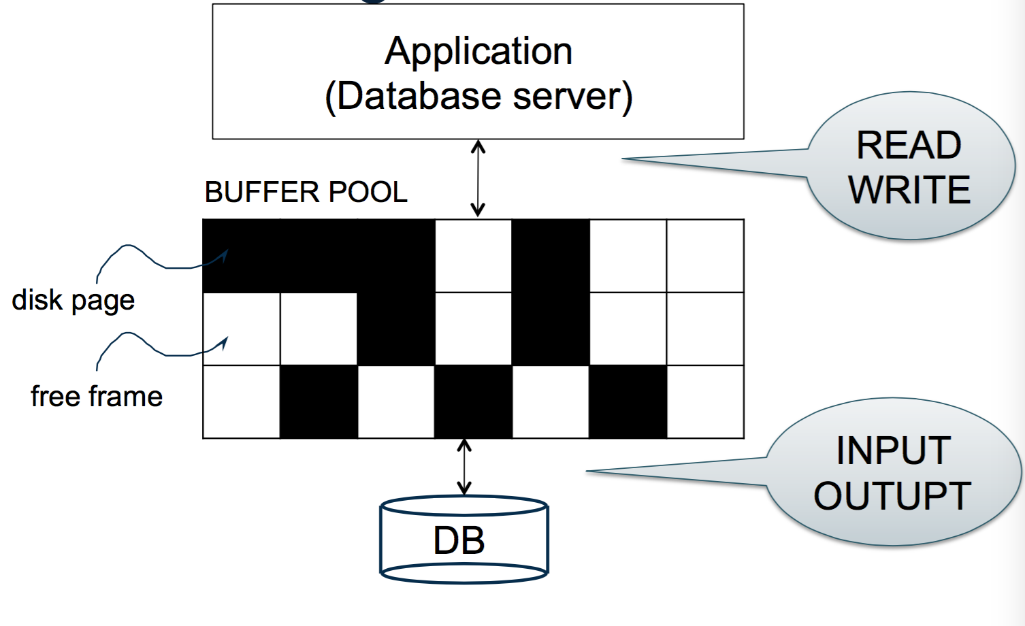
Buffer Management in a DBMS

Slide 7
Read
Compute the data block that contains the item to be read
Either
find a buffer containing the block, or
read from disk into a buffer
Copy the value from the buffer.

Slide 8
Write
Compute the disk block containing the item to be written,
Either
find a buffer containing the block, or
read from disk into a buffer,
Copy the new value into the buffer,
At some point (maybe later), write the buffer back to disk.

Slide 9
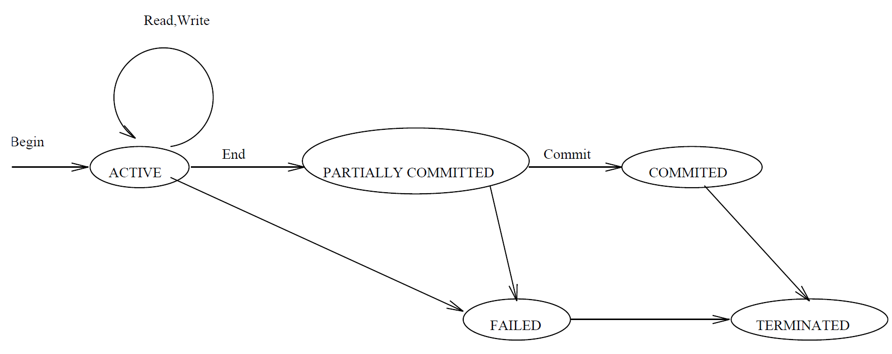
Processing States of a Transaction
The typical processing states are illustrated in the figure below (E/N Fig 17.4):
Partially committed point: At this point, check and enforce the correctness of the concurrent execution.
Committed state: Once a transaction enters the committed state, it has concluded its execution successfully.

Slide 10
Desirable Properties of Transaction Processing ACID
Atomicity(原子性): A transaction is either performed in its entirety or not performed at all.
Consistency preservation（保持一致性）: A correct execution of the transaction must take the database from one consistent state to another.
Isolation（隔离）: A transaction should not make its updates visible to other transactions until it is committed.
Durability or permanency（耐久或永久性）: Once a transaction changes the database and the changes are committed, these changes must never be lost because of subsequent failure.

Slide 11
Problems without Enforcing（强制执行） ACID
For a banking system,
If durability is not enforced, then a customer may lose a deposit.
If consistency preservation is not enforced, then the bank runs a high risk of bankrupt. E.g., run-over upper-limit.
Below are the problems if atomicity and isolation are not enforced in a concurrent execution of transactions.

Slide 12
Lost Update Problem (Isolation is not enforced)
Suppose we have these two transactions, T₁ and T₂:
T1:
read(X)
T2:
read(X)
X ← X + N
write(X) read(Y)
X ← X + M
write(X)
Y ← Y − N
write(Y)
Let us see what may happen if T₁ and T₂ are executed concurrently
in an uncontrolled way:

Slide 13
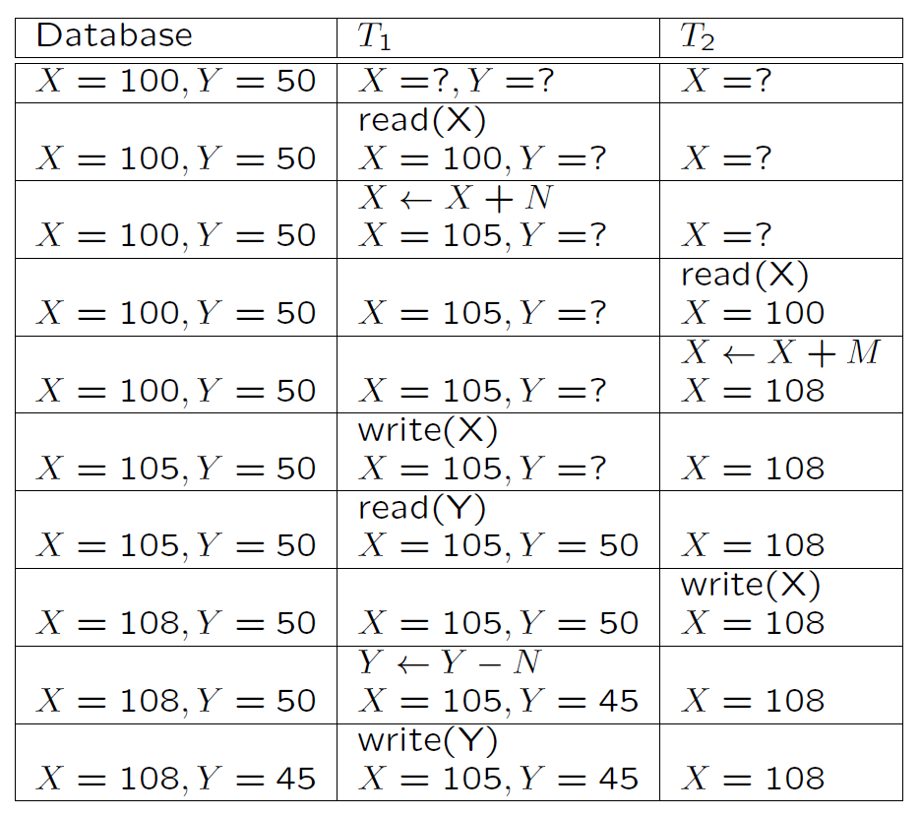
Suppose initially that X = 100; Y = 50;N = 5 and M = 8.

Slide 14
At the end of T₁ and T₂, X should be 113, Y should be 45.
The update X ← X + N has been lost.

Slide 15
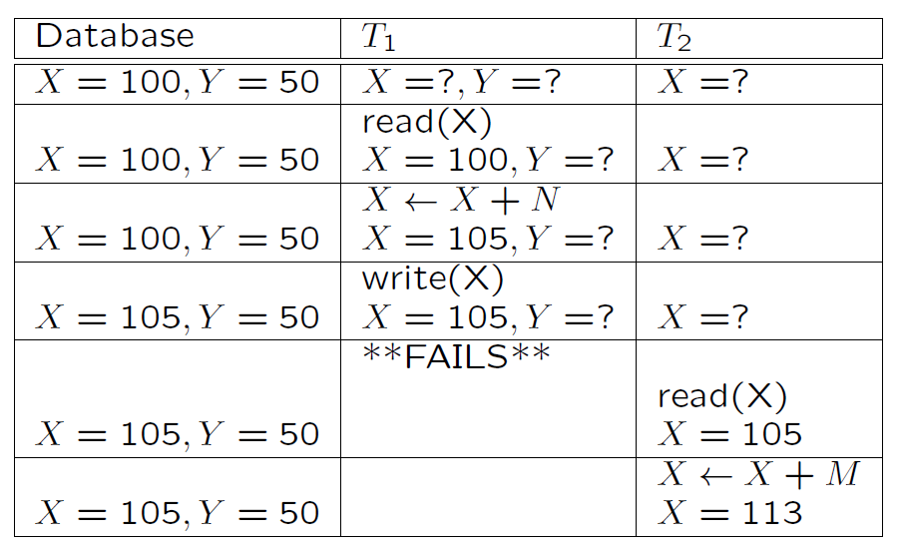
The Temporary Update Problem
Several possibilities for what might happen next:
Recover from the disk

Slide 16
Database | T₁ | T₂
X = 105, Y = 50 |  | X = 113
X= 100, Y = 50 |  | X = 113
X=113, Y=50 |  | Write (X) X= 113
Case 1: DBMS undoes T₁
Database | T₁ | T₂
X = 105, Y = 50 |  | X = 113
X= 105, Y = 50 |  | X = 113
X=113, Y=50 |  | Write (X) X= 113
Case 2: DBMS does nothing to T₁
Database | T₁ | T₂
X = 105, Y = 50 |  | X = 113
X= 105, Y = 50 |  | X = 113
X=100, Y=50 |  | Write (X), X= 113 X = 100
Case 3: DBMS undoes T₁

Slide 17
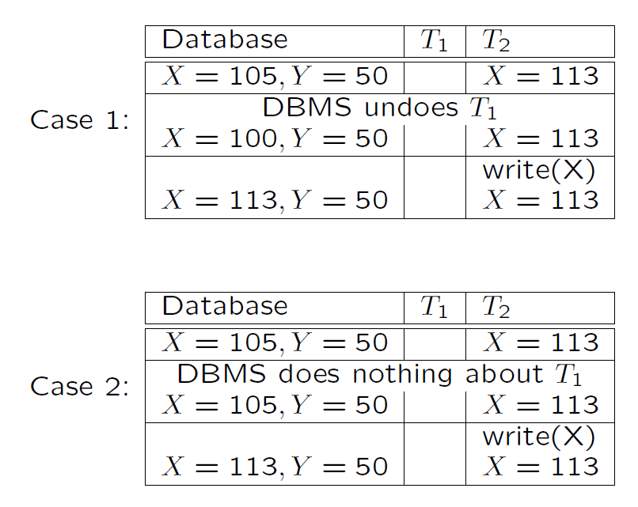

Slide 18
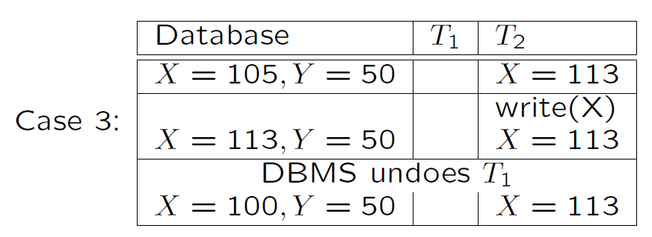
In case 1 and 2, only half of T₁ has been executed.
In case 3, T₂ has been lost.

Slide 19
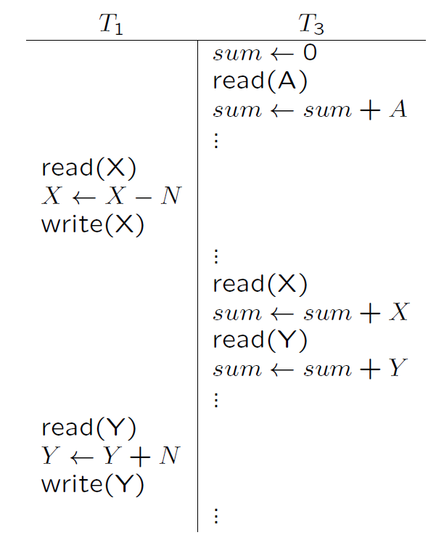
The Incorrect Summary Problem
Here the sum calculated by T₃ will be wrong by N.

Slide 20
Recover from Failures
Ensure the A in ACID
Log-based Recovery
Undo logging
Redo logging
Undo/Redo logging

Slide 21
System Log
System Log
The system needs to record the states information to recover failures correctly.
The information is maintained in a log (also called journal or audit trail（日志、审计跟踪）).
The system log is kept in hard disk but maintains its current contents in main memory.

Slide 22
System Log
Start transaction marker [start transaction, T]: Records that transaction T has started execution.
[read item, T, X]: Records that transaction T has read the value of database item X.
[write item, T, X, old value, new value]: Records that T has changed the value of database item X from old value to new value.
Commit transaction marker [commit, T]: Records that transaction T has completed successfully, and arms that its effect can be committed (recorded permanently) to the database.
[abort, T]: Records that transaction T has been aborted.

Slide 23
System Log (Cont’d)
In fact some other entries (rollback, undo, redo) are also required for a recovery method.
These entries allow the recovery manager to rollback an unsuccessful transaction (undo any partial updates).

Slide 24
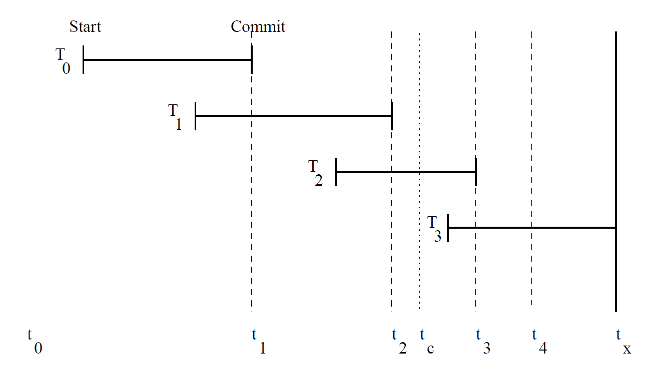
Recovery
Let us see how the log might be used to recover from a system crash.
The diagram below shows transactions between the last system backup and a crash.

Slide 25
Recovery (Cont’d)
The database on disk will be in a state somewhere between that at t₀ and the state at t_{x}.
The same is also true for log entries.

Slide 26
Recovery (Cont’d)
We will assume that the write-ahead log strategy is used. This means that
old data values must be force-written to the log (i.e. the buffer must be copied to disk) before any change can be made to the database, and
the transaction is regarded as committed when the new data values and the commit marker have been force-written to the log.
Thus the log is force-written at least at t₁, t₂ and t₃ in the above.

Slide 27
Suppose the log was last written to disk at t₄.
By examining the log:
We know that T₀, T₁ and T₂ have committed and their effects should be reflected in the database after recovery.
But we do not know whether the effects of T₀, T₁ and T₂ were reflected at the time of the crash.
We also know that T₃ has started, may have modified some data, but is not committed. Thus T₃ should be undone.

Slide 28
The database can be recovered by rolling back T₃ using the old data values from the log, and redoing the changes made by T₀ … T₂ using the new data values (for these committed transactions) from the log.
Notice that instead of rolling back, the database could have been restored from the backup. This might be necessary in the event of a disk crash for example (for this reason, the log should be stored on an independent disk pack).

Slide 29
Checkpoints
Notice also that using this system, the longer the time between crashes, the longer recovery may take.
To avoid this problem, the system may take checkpoints at regular intervals.
To do this:
a start of checkpoint marker is written to the log, then
the database updates in buffers are force-written, then
an end of checkpoint marker is written to the log.

Slide 30
In our example, suppose a checkpoint is taken at time t_{c}. Then on recovery we only need redo T₂.

Slide 31
Recall: Desirable Properties of Transaction Processing: ACID
Atomicity: A transaction is either performed in its entirety or not performed at all.
Consistency preservation: A correct execution of the transaction must take the database from one consistent state to another.
Isolation: A transaction should not make its updates visible to other transactions until it is committed.
Durability or permanency: Once a transaction changes the database and the changes are committed, these changes must never be lost because of subsequent failure.

Slide 32
Concurrency Control(并发控制)
Multiple concurrent transactions T₁, T₂, …
They read/write common elements A₁, A₂, …
How can we prevent unwanted interference?
The Scheduler is responsible for that

Slide 33
Schedules of Transactions
To fully utilise resources, desirable to interleave the operations of transactions in an appropriate way.
For example, if one transaction is waiting for I/O to complete, another transaction can use the CPU.
A schedule S of the transactions T₁,…, T_{n}
is a sequential ordering of the operations of T₁,…, T_{n}, and
preserves the ordering of operations in each transaction T_{i}.

Slide 34
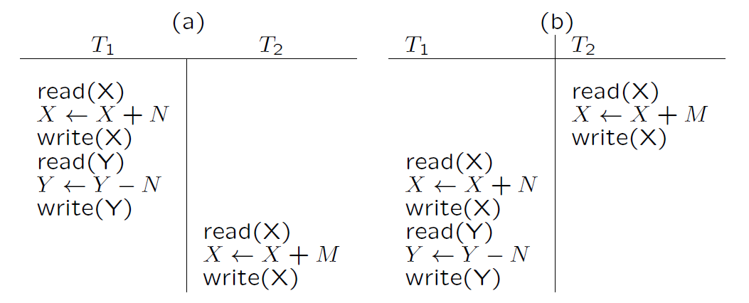
Example Schedules

Slide 35
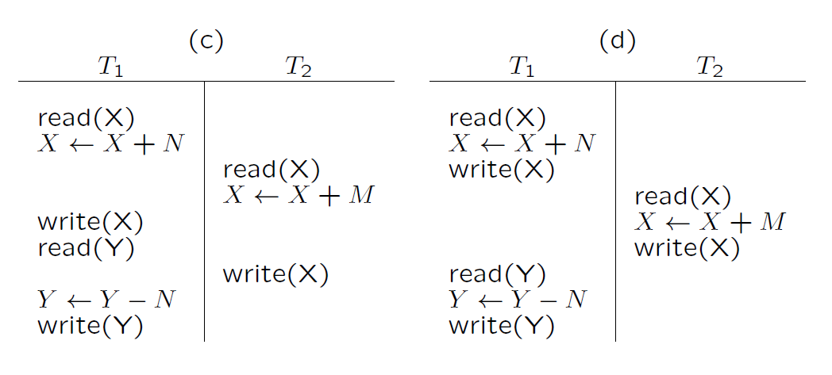
Example Schedules (Cont.)

Slide 36
Serial（串行） Schedule
As we have seen, if operations are interleaved arbitrarily, incorrect results may occur.
However, it is reasonable to assume that schedules (a) and (b) in the figure will give correct results (as long as the transactions are independent).
(a) and (b) are called serial schedules, and we will assume that any serial schedule is correct.

Slide 37
Serializable （序列化）Schedule
Notice that schedule (d) always produces the same result as schedules (a) and (b), so it should also give correct results.
A schedule is serializable if it always produces the same result as some serial schedule.
Notice that schedule (c) is not serializable.

Slide 38
Scheduling Transactions
Serial schedule: Schedule that does not interleave the actions of different transactions.
Equivalent schedules: For any database state, the effect (on the set of objects in the database) of executing the first schedule is identical to the effect of executing the second schedule.
Serializable schedule: A schedule over a set S of transactions is equivalent to some serial execution of the set of committed transactions in S.
Serializability
Note: If each transaction preserves consistency, every serializable schedule preserves consistency.

Slide 39
Conflict Serializable Schedules
Two schedules are conflict equivalent if:
Involve the same actions of the same transactions
Every pair of conflicting actions is ordered the same way
Schedule S is conflict serializable if S is conflict equivalent to some serial schedule

Slide 40
Conflict Serializability
Any conflict serializable schedule is also a serializable schedule (why ?)
The inverse is not true.
Lost write
w₁(Y); w₂(Y); w₂(X); w₁(X); w₃(X);
Equivalent, but not
conflict equivalent
w₁(Y); w₁(X); w₂(Y); w₂(X); w₃(X);

Slide 41
Testing Conflict Serializable
Why not run only serial schedules? That is, run one transaction after the other?
When there are only two transactions, there are only two serial schedules - for n transactions there will be n!.
Fortunately there is an efficient algorithm to check whether a schedule is conflict serializable without checking all these possibilities.
Because of very poor throughput due to disk latency

Slide 42
Check Conflict Serializability
Algorithm
Step 1: Construct a schedule (or precedence) graph – a directed graph.
Step 2: Check if the graph is cyclic:
Cyclic: non-serializable（不可序列）.
Acyclic: serializable.

Slide 43
A directed graph G = (V, A) consists of
a vertex set V, and
an arc set A such that each arc connects two vertices.
G is cyclic if G contains a directed cycle（定向循环）.
Cyclic Graph

Slide 44
Construct a Schedule Graph G_{S} = (V, A) for a schedule S
A vertex in V represents a transaction.
For two vertices T_{i} and T_{j}, an arc T_{i} →T_{j} is added to A if
there are two conflicting operations O₁ ∈ T_{i} and O₂ ∈ T_{j},
in S, O₁ is before O₂.
Two operations O₁ and O₂ are conflicting if
they are in different transactions but on the same data item,
one of them must be a write.

Slide 45
Example 1
r₂(A); r₁(B); w₂(A); r₃(A); w₁(B); w₃(A); r₂(B); w₂(B)
B
A
1
2
3
This schedule is conflict-serializable

Slide 46
Example 2
r₂(A); r₁(B); w₂(A); r₂(B); r₃(A); w₁(B); w₃(A); w₂(B)
B
A
1
B
2
3
This schedule is NOT conflict-serializable

Slide 47
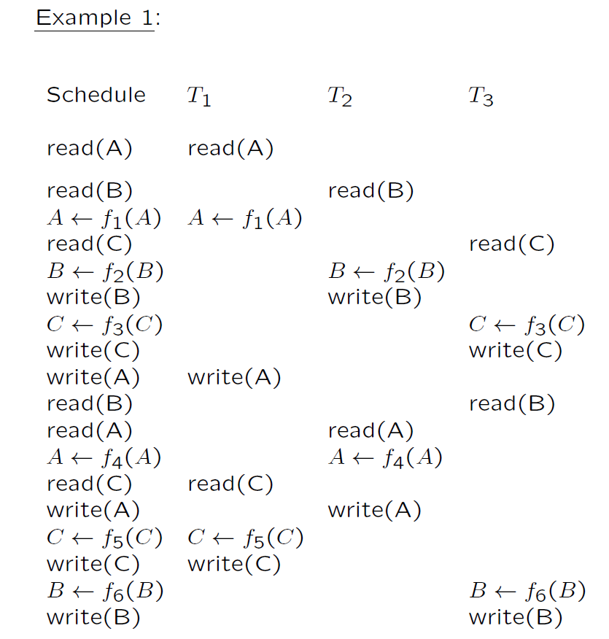

Slide 48
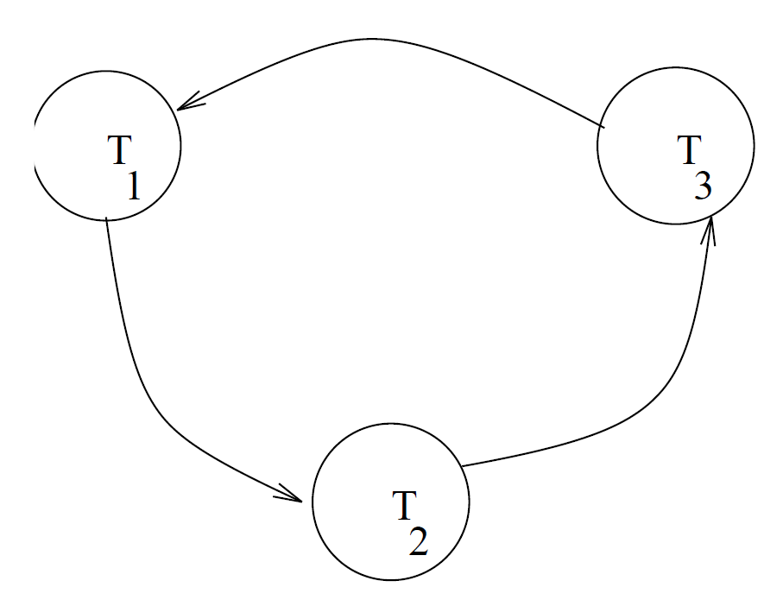

Slide 49
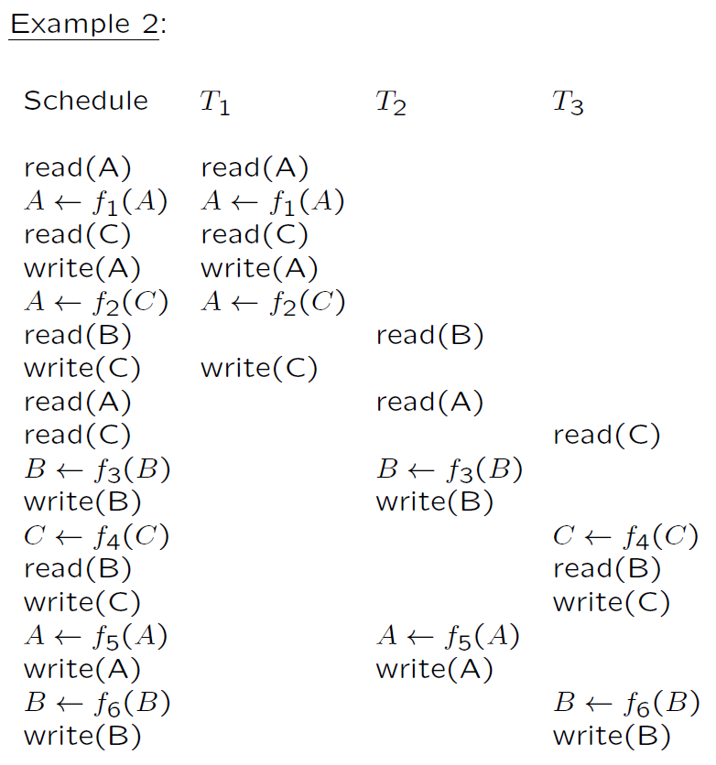

Slide 50
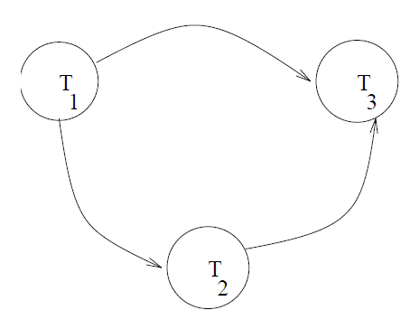
Unfortunately, testing for serializability on the fly is not practical.
Instead, a number of protocols have been developed which ensure that if every transaction obeys the rules, then every schedule will be serializable, and thus correct.

Slide 51
Concurrency Control Methods
Locking Mechanism
The idea of locking some data item X is to:
give a transaction exclusive use of the data item X,
do not restrict the access of other data items.
This prevents one transaction from changing a data item currently being used in another transaction.
We will discuss a simple locking scheme which locks individual items, using read and write locks

Slide 52
Locking Rules
In this schema, every transaction T must obey the following rules.
1) If T has only one operation (read/write) manipulating an item X:
obtain a read lock on X before reading it,
obtain a write lock on X before writing it,
unlock X when done with it.
2) If T has several operations manipulating X:
obtain one proper lock only on X:
a read lock if all operations on X are reads;
a write lock if one of these operations on X is a write.
unlock X after the last operation on X in T has been executed.

Slide 53
Locking Rules (cont.)
In this scheme,
Several read locks can be issued on the same data item at the same time.
A read lock and a write lock cannot be issued on the same data item at the same time, neither two write locks.
This still does not guarantee serializability.

Slide 54
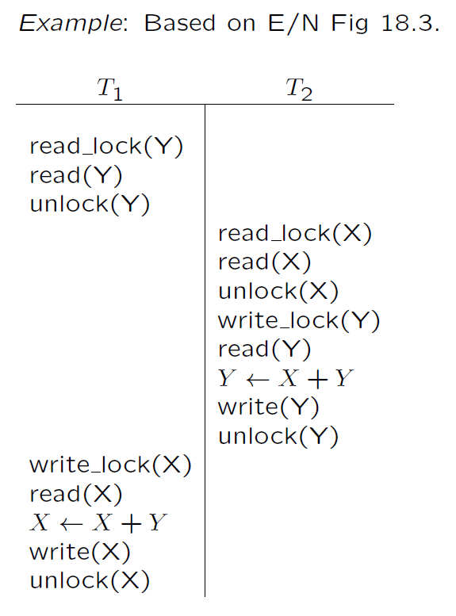

Slide 55
Two Phase Locking (2PL)
To guarantee serializability, transactions must also obey the two-phase locking protocol:
Growing Phase: all locks for a transaction must be obtained before any locks are released, and
Shrinking Phase: gradually release all locks (once a lock is released no new locks may be requested).

Slide 56
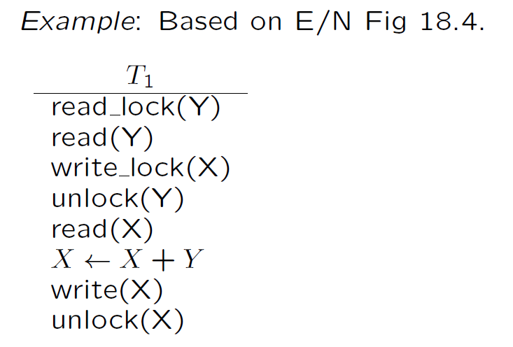
Two Phase Locking (2PL) (Cont.)
Locking thus provides a solution to the problem of correctness of schedules.
Two phase locking ensures conflict serializability

Slide 57
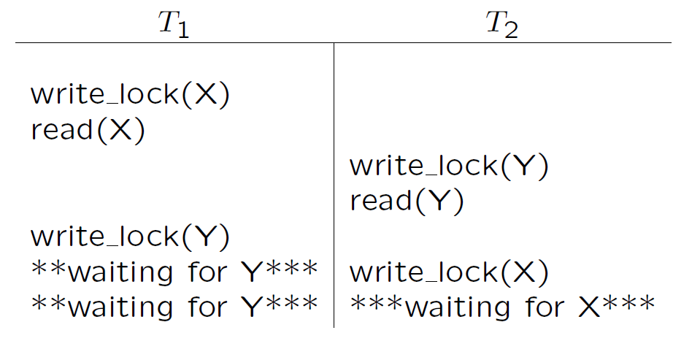
Deadlock
A problem that arises with locking is deadlock.
Deadlock occurs when two transactions are each waiting for a lock on an item held by the other.

Slide 58
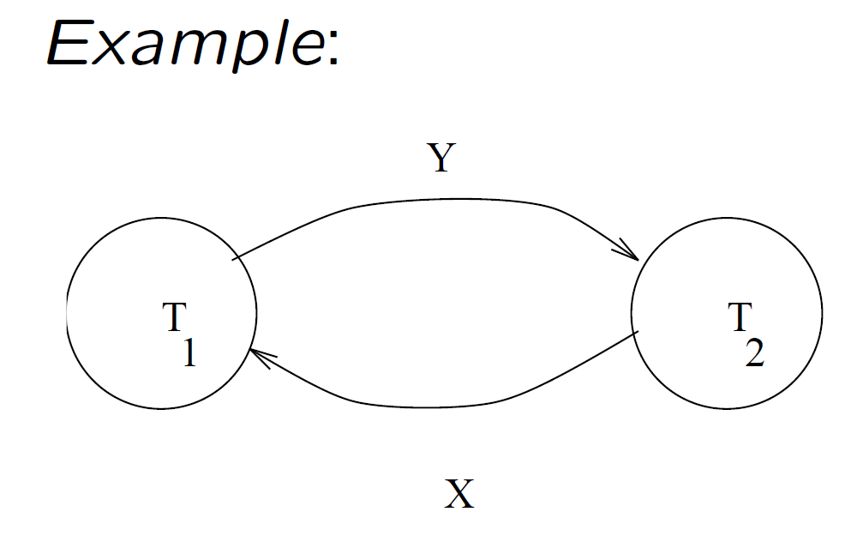
Deadlock Check
Create the wait-for graph for currently active transactions:
create a vertex for each transaction; and
an arc from T_{i} to T_{j} if T_{i} is waiting for an item locked by T_{j}.
If the graph has a cycle, then a deadlock has occurred.

Slide 59
Several methods to deal with deadlocks
deadlock detection
periodically check for deadlocks, abort and rollback some transactions (restart them later). This is a good choice if transactions are very short or very independent.

Slide 60
Several methods to deal with deadlocks (Cont.)
deadlock prevention - Assign priorities based on timestamps. Assume Ti wants a lock that Tj holds. Two policies are possible:
Wait-Die: If Ti has higher priority, Ti waits for Tj; otherwise Ti aborts
Wound-wait: If Ti has higher priority, Tj aborts; otherwise Ti waits
If a transaction re-starts, make sure it has its original timestamp

Slide 61
Timestamp ordering（时间戳排序）
The idea here is:
to assign each transaction a timestamp (e.g. start time of transaction), and
to ensure that the schedule used is equivalent to executing the transactions in timestamp order

Slide 62
Each data item, X, is assigned
a read timestamp, read TS(X) - the latest timestamp of a transaction that read X, and
a write timestamp, write TS(X) - the latest timestamp of a transaction that write X.

Slide 63
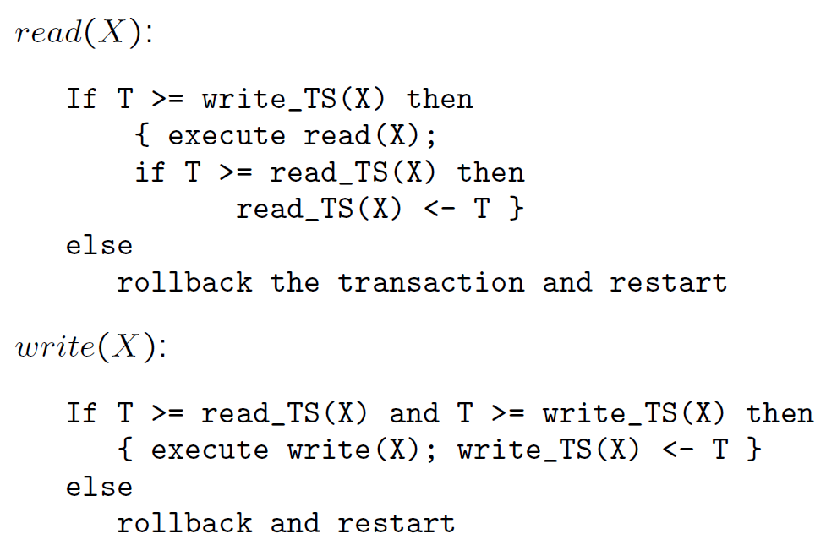
These are used in read and write operations as follows. Suppose the transaction timestamp is T.

Slide 64
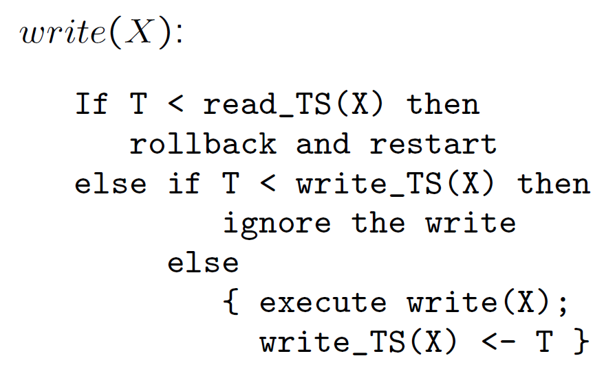
Thomas' write rule:

Slide 65
Some problems:
Cyclic restart: There is no deadlock, but a kind of livelock can occur - some transactions may be constantly aborted and restarted.
Cascading rollback: When a transaction is rolled back, so are any transactions which read a value written by it, and any transactions which read a value written by them . . . etc. This can be avoided by not allowing transactions to read values written by uncommitted transactions (make them wait).

Slide 66
Multiversioning
Similar to the timestamp ordering approach; but is allowed to access “old” versions of a table.
A history of the values and timestamps (versions) of each item is kept.
When the value of an item is needed, the system chooses a proper version of the item that maintains serializability.
This results in fewer aborted transactions at the cost of greater complexity to maintain more versions of each item.

Slide 67
We will look at a scheme, several versions X₁,…,X_{k} of each data item are kept. For each X_{i} we also keep
read TS(X_{i}) - as for timestamp ordering.
write TS(X_{i}) - as for timestamp ordering.

Slide 68
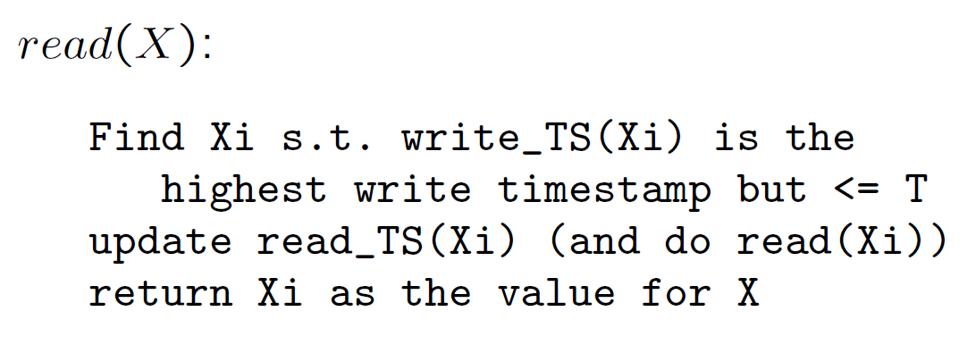
Read and write are done as follows for a transaction P with timestamp T.

Slide 69
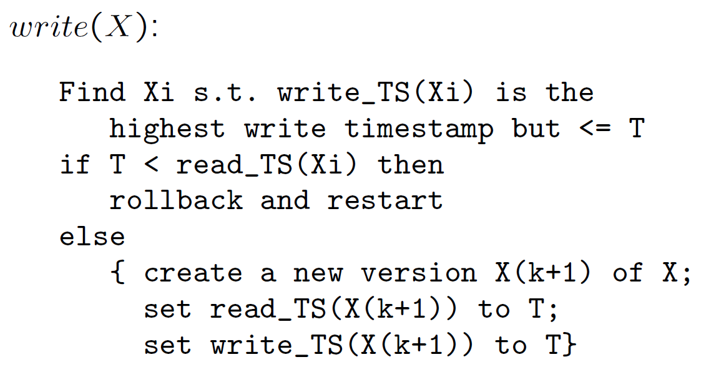
Note: Cascading rollback and cyclic restart problems can still occur, but should be reduced.
However, there is an increased overhead in maintaining multiple versions of items.

Slide 70
Optimistic scheduling
In two-phase locking, timestamp ordering, and multiversioning concurrency control techniques, a certain degree of checking is done before a database operation can be executed.
The idea here is to push on and hope for the best!
No checking is done while the transaction is executing.

Slide 71
The protocol has three phases.
read phase - A transaction can read data items from the database into local variables. However, updates are applied only to local copies of the data items kept in the transaction workspace.
validation phase - checks are made to ensure that serializability is not violated,
write phase -if validation succeeds, updates are applied and the transaction is committed. Otherwise, the updates are discarded and the transaction is restarted.

Slide 72
A scheme uses timestamps and keeps each transaction's
read-set - the set of items read by the transaction,
write-set - the set of items written by the transaction.
During validation, we check that the transaction does not interfere with any transaction that is committed or currently validating.

Slide 73
Each transaction T is assigned 3 timestamps:
Start(T), Validation(T), Finish(T).
To pass the validation test for T, one of the following must be true:
1. Finish(S) < Start(T); or
2. for S s.t. Start(T) < Finish(S), then
write set of S is disjoint from the read set of T, and
Finish(S) < Validation(T).

Slide 74
Optimistic control is a good option if there is not much interaction between transactions.

Slide 75
2PL vs. TSO vs. MV vs. OP
A Comparison among two-phase locking (2PL), timestamp ordering (TSO), multiversioning (MV), optimistic (OP) concurrency control techniques.
MV should provide the greatest concurrency degree (in average). However, we need to maintain multiversions for each data item.
2PL can offer the second greatest concurrency degree (in average); but will result in deadlocks. To resolve the deadlocks, either
need additional computation to detect deadlocks and to resolve the deadlocks, or
reduce the concurrency degree to prevent deadlocks by adding other restrictions.

Slide 76
2PL vs. TSO vs. MV vs. OP (cont.)
If most transactions are very short, we can use 2PL + deadlock detection and resolution.
TSO has a less concurrency degree than that of 2PL if a proper deadlock resolution is found. However, TSO does not cause deadlocks. Other problems, such as cyclic restart and cascading rollback, will appear in TSO.
If there are not much interaction between transactions, OP is a very good choice. Otherwise, OP is a bad choice.

